Slide 1


SQL PROJECT BANK CRM
Ravneet Singh

Slide 2

INTRODUCTION
Analytical CRM Development for a Bank involves the implementation of advanced analytics and intelligent decision-making tools to enhance customer experiences and drive business growth. This specialized CRM system enables banks to analyze customer data comprehensively, identify trends, and make data-driven decisions. By leveraging analytical capabilities, banks can segment customers, track behaviors, predict patterns, and monitor changes effectively. The goal is to improve customer engagement, satisfaction, and retention by tailoring marketing campaigns and personalized offers based on data insights. Analytical CRM in the banking sector plays a crucial role in understanding customer behavior, enhancing operational efficiency, and ultimately fostering long-term customer relationships

Slide 3

PROBLEM STATEMENT
Customer churn, the rate at which customers stop using a company's products or services, is a crucial metric for banks. It directly impacts revenue and profitability. In this presentation, we will analyze our bank's customer churn rates, focusing on gender, recent years, customers with credit cards, number of products used, credit score-wise churn count, and geography-wise churn count. Our goal is to identify factors contributing to churn and propose strategies to improve customer retention and satisfaction.

Slide 4
DATA OVERVIEW
RowNumber: The row number in the dataset, likely used for reference or indexing.
CustomerId: A unique identifier for each customer.
CreditScore: A numerical representation of the customer's creditworthiness.
Credit score:
Super Prime: 721–850
Prime: 661–720
Near Prime: 621–660
Sub Prime: 581–620
Deep Subprime: <580
GeographyID: A numerical identifier that likely corresponds to a geographical location, such as a country or region.
GenderID: A numerical identifier for the customer's gender, where for example, '1' could represent male and '2' could represent female.
Age: The age of the customer.

Slide 5
Tenure: The number of years the customer has been with the bank.
Balance: Current balance in the customer's account.
NumOfProducts: refers to the number of products that a customer has purchased through the bank.
HasCrCard: denotes whether or not a customer has a credit card. This column is also relevant, since people with a credit card are less likely to leave the bank.
1 represents credit card holder
0 represents non credit card holder
IsActiveMember: active customers are less likely to leave the bank (as per the criteria defined by the bank for identifying the activeness).
1 represents Active Member
0 represents Inactive Member
Estimated Salary: as with balance, people with lower salaries are more likely to leave the bank compared to those with higher salaries.
Exited: whether or not the customer left the bank.
0 represents Retain
1 represents Exit
Bank DOJ: date when the Customer associated/joined with the bank.

Slide 6

DATA SCRUBBING
Handling Missing Values:
Identified and removed missing values in the active customers
Data Consistency:
Cleaned special characters from the Surname column using string manipulation functions.
Ensured correct data types for critical columns:
Converted numeric values in the Bank_DOJ column to date format.
Converted numeric values in the Age column to text format.
Inconsistency Correction:
Detected and rectified 735 rows where exited customers were incorrectly marked as active.
SQL query used to update the IsActiveMember column for accurate churn status.

Slide 7
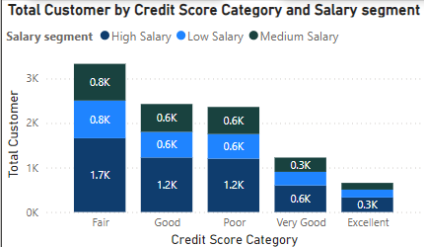
KEY INSIGHTS OF OBJECTIVES
Analyzed total, average, max, and min balances across France, Spain, and Germany.
Identified top 5 customers with highest estimated salaries in the last quarter.
Found that customers with a credit card use an average number of products.
Calculated churn rates for female and male customers for the most recent year.
Compared average credit scores between exited and retained customers.
Customers with a credit score below 580 have the highest exit rate.
France has the most active customers with a tenure > 5 years.
Both credit card holders and non-holders show similar churn rates.

Slide 8
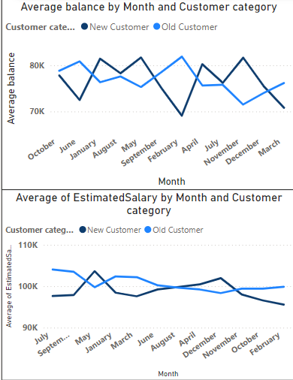
KEY INSIGHTS OF SUBJECTIVES
Data discrepancies, such as exited customers marked as active, need resolution to ensure accurate analysis.
Weak correlation between salary and balance suggests other factors significantly influence balance
Variables like balance, estimated salary, and credit score are crucial in predicting customer churn.
Understanding the average tenure and balance of customers provides insights into customer lifetime value and retention strategies.
Regional differences in customer behaviour and balances suggest the need for tailored regional strategies.
Customers who engage with more bank products are less likely to churn, highlighting the importance of cross-selling.

Slide 9
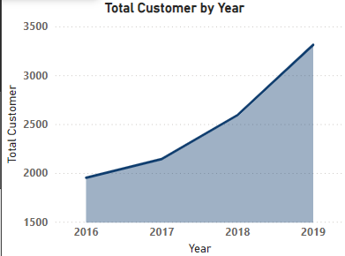
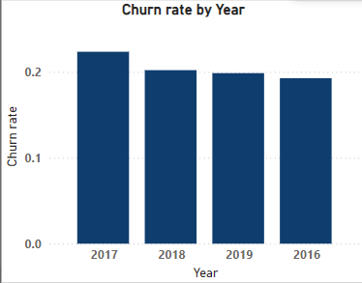
CUSTOMER VS CHURN RATE YEARS
Customer years
The increase in new customers joining the bank each year is a positive trend, indicating potential growth opportunities.
However, the constant churn rate suggests that while new customers are joining, the bank is struggling to retain them.
Churn Rate years
Fluctuations in churn rates occurred, but overall, the rate has stabilized.
Minor increase in 2017, but stabilized in subsequent years.

Slide 10

RECOMMENDATION
Enhance credit score monitoring and management practices to improve churn rankings and customer loyalty.
Conduct further investigation into outliers in account balances to understand underlying reasons and tailor retention efforts accordingly.
Implement targeted retention strategies based on age group churn rates to address specific demographic needs and preferences.

Slide 11
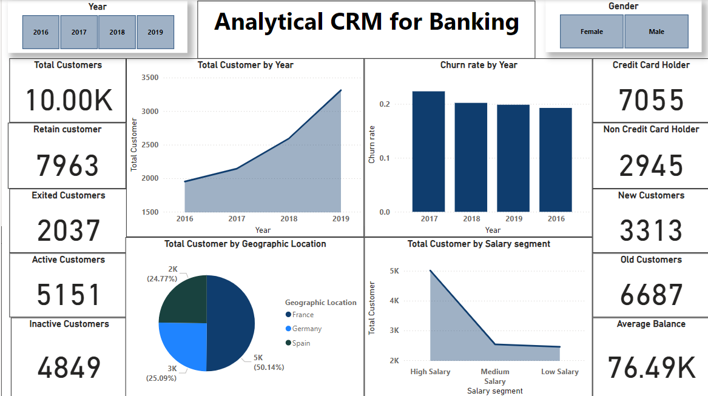
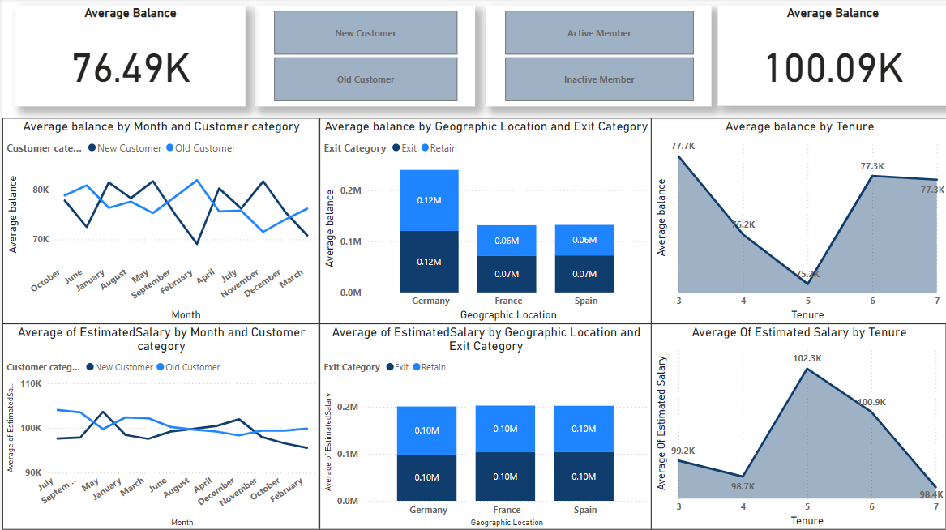
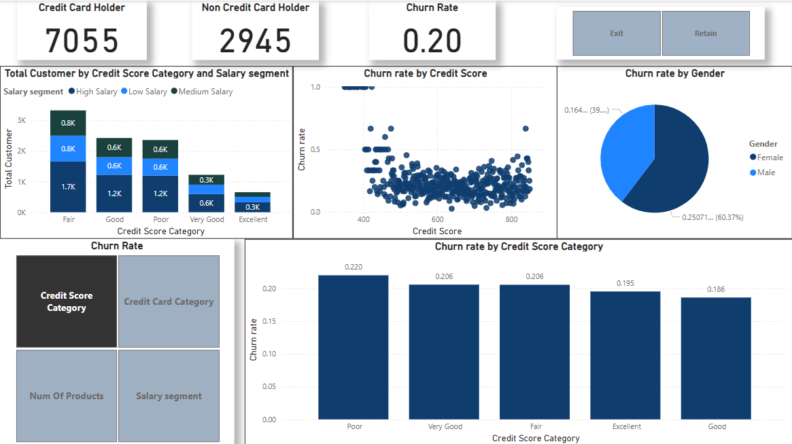
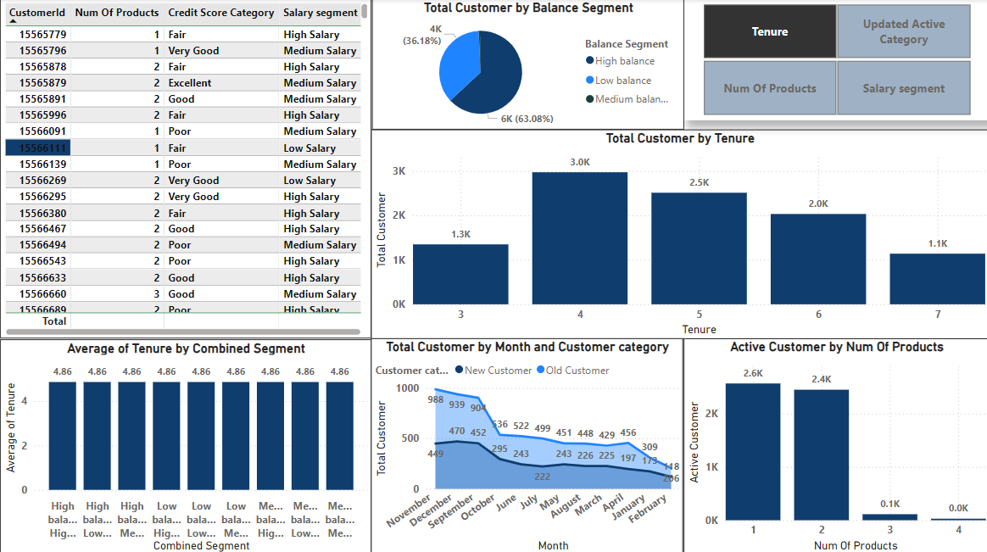
POWER BI DASHBOARD
Customer
Balance & Salary
Churn Rate
further Analysis

Slide 12

CONCLUSION
In conclusion, the comprehensive analysis conducted on bank churn data has provided invaluable insights into customer behavior, preferences, and patterns. By leveraging both objective and subjective analyses, we have identified key factors influencing churn rates, including age group dynamics, account balance outliers, and credit score rankings. These findings underscore the critical importance of data-driven decision-making in the banking sector.
Moving forward, it is recommended that the bank implements targeted retention strategies tailored to specific age groups to address demographic nuances effectively. Additionally, further investigation into outliers in account balances is essential to understand underlying factors and develop personalized retention efforts. Moreover, enhancing credit score monitoring and management practices will be instrumental in improving churn rankings and fostering greater customer loyalty.
In essence, this analysis highlights the significance of leveraging data analytics to drive informed business strategies. By acting upon these recommendations, the bank can not only reduce churn rates but also enhance overall customer satisfaction and retention, ultimately leading to sustained growth and success in the competitive banking landscape.

Slide 13

THANK YOU

